Slide 1
Louisiana Senate
Finance Committee
FY25 Executive Budget
03 – Department of Veterans Affairs
March 2024
Senator Cameron Henry, President
Senator Glen Womack, Chairman

Slide 2
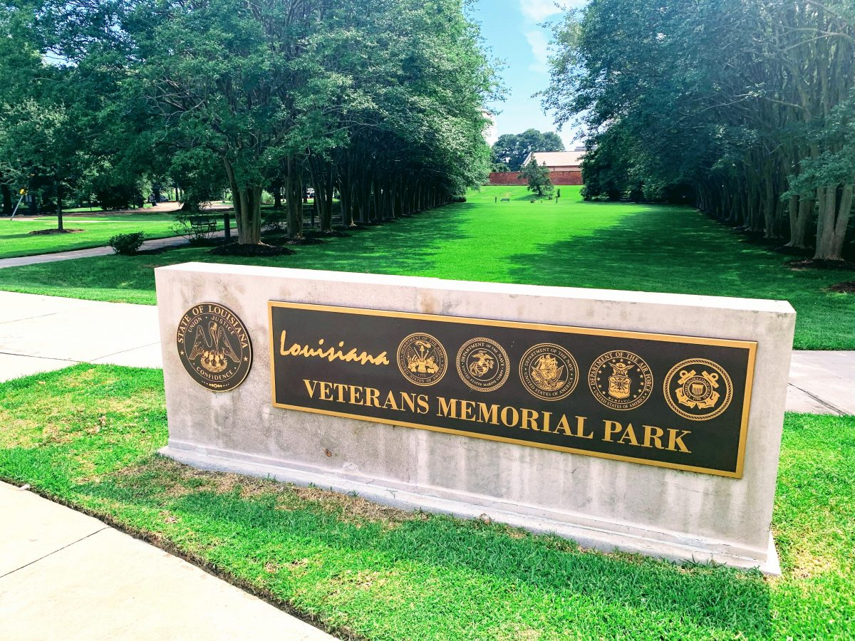
FY25 Executive Budget
Schedule 03 — Veterans Affairs Agencies
Departmental mission: “To provide comprehensive care and quality service to Louisiana’s Veterans and their families with regard to health care, education, disability benefits, long-term care and burial honors.”
03-130
Veterans Affairs
Administrative
03-131
Louisiana Veterans Home
Appeals
Contact Assistance
State Approval Agency
State Veterans Cemetery
03-132
Northeast Louisiana Veterans Home
03-134
Southwest Louisiana Veterans Home
03-135
Northwest Louisiana Veterans Home
03-136
Southeast Louisiana Veterans Home
The five Veterans Homes provide medical and nursing care to eligible Louisiana veterans.
Louisiana Department of Veterans Affairs
Charlton Meginley, COL (USAF Ret.), Secretary

Slide 3
Veterans Affairs
Program Descriptions
Administrative Program
Provides the service programs of the Department, as well as the Louisiana Veterans Home, Northeast Louisiana Veterans Home, Northwest Louisiana Veterans Home, Southwest Louisiana Veterans Home, and Southeast Louisiana Veterans Home with administrative and support personnel, assistance, and training necessary to carry out the efficient operation of the activities.
Appeals Program
Reviews veterans’ initial rating decisions for errors, prepares appeal briefs to the U.S. Department of Veterans Affairs, counsels veterans on their appeals rights, and also provides representation for them at the Board of Veterans Appeals hearings.
Contact Assistance Program
Operates offices throughout the state to inform veterans and/or their dependents of federal and state benefits to which they are entitled, and assists in applying for and securing these benefits.
State Approval Agency
Conducts inspections and provides technical assistance to programs of education pursued by veterans and other eligible persons under statute. The program also works to ensure that programs of education, job training, and flight schools are approved in accordance with Title 38, relative to plan of operation and veterans administration contract.
State Veterans Cemetery
State Veterans Cemetery consists of the Northwest Louisiana Veterans Cemetery in Keithville, the Central Louisiana Veterans Cemetery in Leesville, the Southeast Louisiana Veterans Cemetery in Slidell, the Northeast Louisiana Veterans Cemetery in Rayville, and the Southwest Louisiana Veterans Cemetery in Jennings.
Veterans Homes
Provide medical and nursing care to eligible Louisiana veterans in an effort to return the veteran to the highest physical and mental capacity. There are 5 veterans homes across the state. Each facility offers a variety of services including: Long and short-term care; Rehabilitative therapies; Alzheimer’s and intermediate care; Skilled nursing; Mental health services; and Centralized pharmacy services.
3

Slide 4
Veterans Affairs
Benefits for Louisiana’s 267,000 Veterans
Veterans Assistance Counselors help veterans and their families receive benefits for which they qualify.
General eligibility requirements include military service and Louisiana state residency. Specific programs may have additional requirements. Spouses and dependents of deceased veterans who meet eligibility requirements may also be eligible for certain programs and services.
Examples: |  |  |  | Source: | Louisiana Department of Veterans Affairs
Tragedy Assistance Program for Survivors (TAPS) | Military Funeral Honors | Veterans Cemeteries | LA National Guard Death and Disability Benefits | Military In-State Tuition Status | The Medal of Honor Character Development Program
Louisiana Veterans Homes | Combat Pay Exception | Survivor and Dependent Education | Free Military Honor plate | Montgomery GI Bill & Post 9/11 Bill | Specialty La. License plates
Military training towards education/certification credits | Louisiana Veterans Honor Medal | Louisiana Title 29 Dependents’ Educational Assistance | Military Family Assistance (MFA) Fund | VA Healthcare System | VA Disability Payments
Licensing and Certification | State and Federal Civil Service | Business and Career Solutions Centers | Homestead Exemption | Designation and discounts on license plates | VA Work Study Program
Discounts for licenses and state parks | VA Guaranteed Home Loans | Veteran GI Bill Apprenticeship and OJT Program, | Veterans First Business Initiative | Supporting Veteran Farmers | VA Pension
4

Slide 5
Veterans Affairs
Louisiana Cemetery Benefits
LDVA operates five veterans cemeteries located across the state, offering a variety of burial options for veterans, spouses and dependent children.
Each location features beautiful and spacious grounds, covered shelter for committal services and are open Monday through Friday for interments with visitation open daily.
Burial benefits may include the following:
Grave sites for casket or cremated remains,
Headstones or markers,
Opening and closing of the graves, and
Continued perpetual care.
NW La.
Veterans
Cemetery
Keithville
NE La.
Veterans
Cemetery
Rayville
Central La.
Veterans
Cemetery
Leesville
SE La.
Veterans Cemetery
Slidell
SW La.
Veterans
Cemetery
Jennings
5

Slide 6
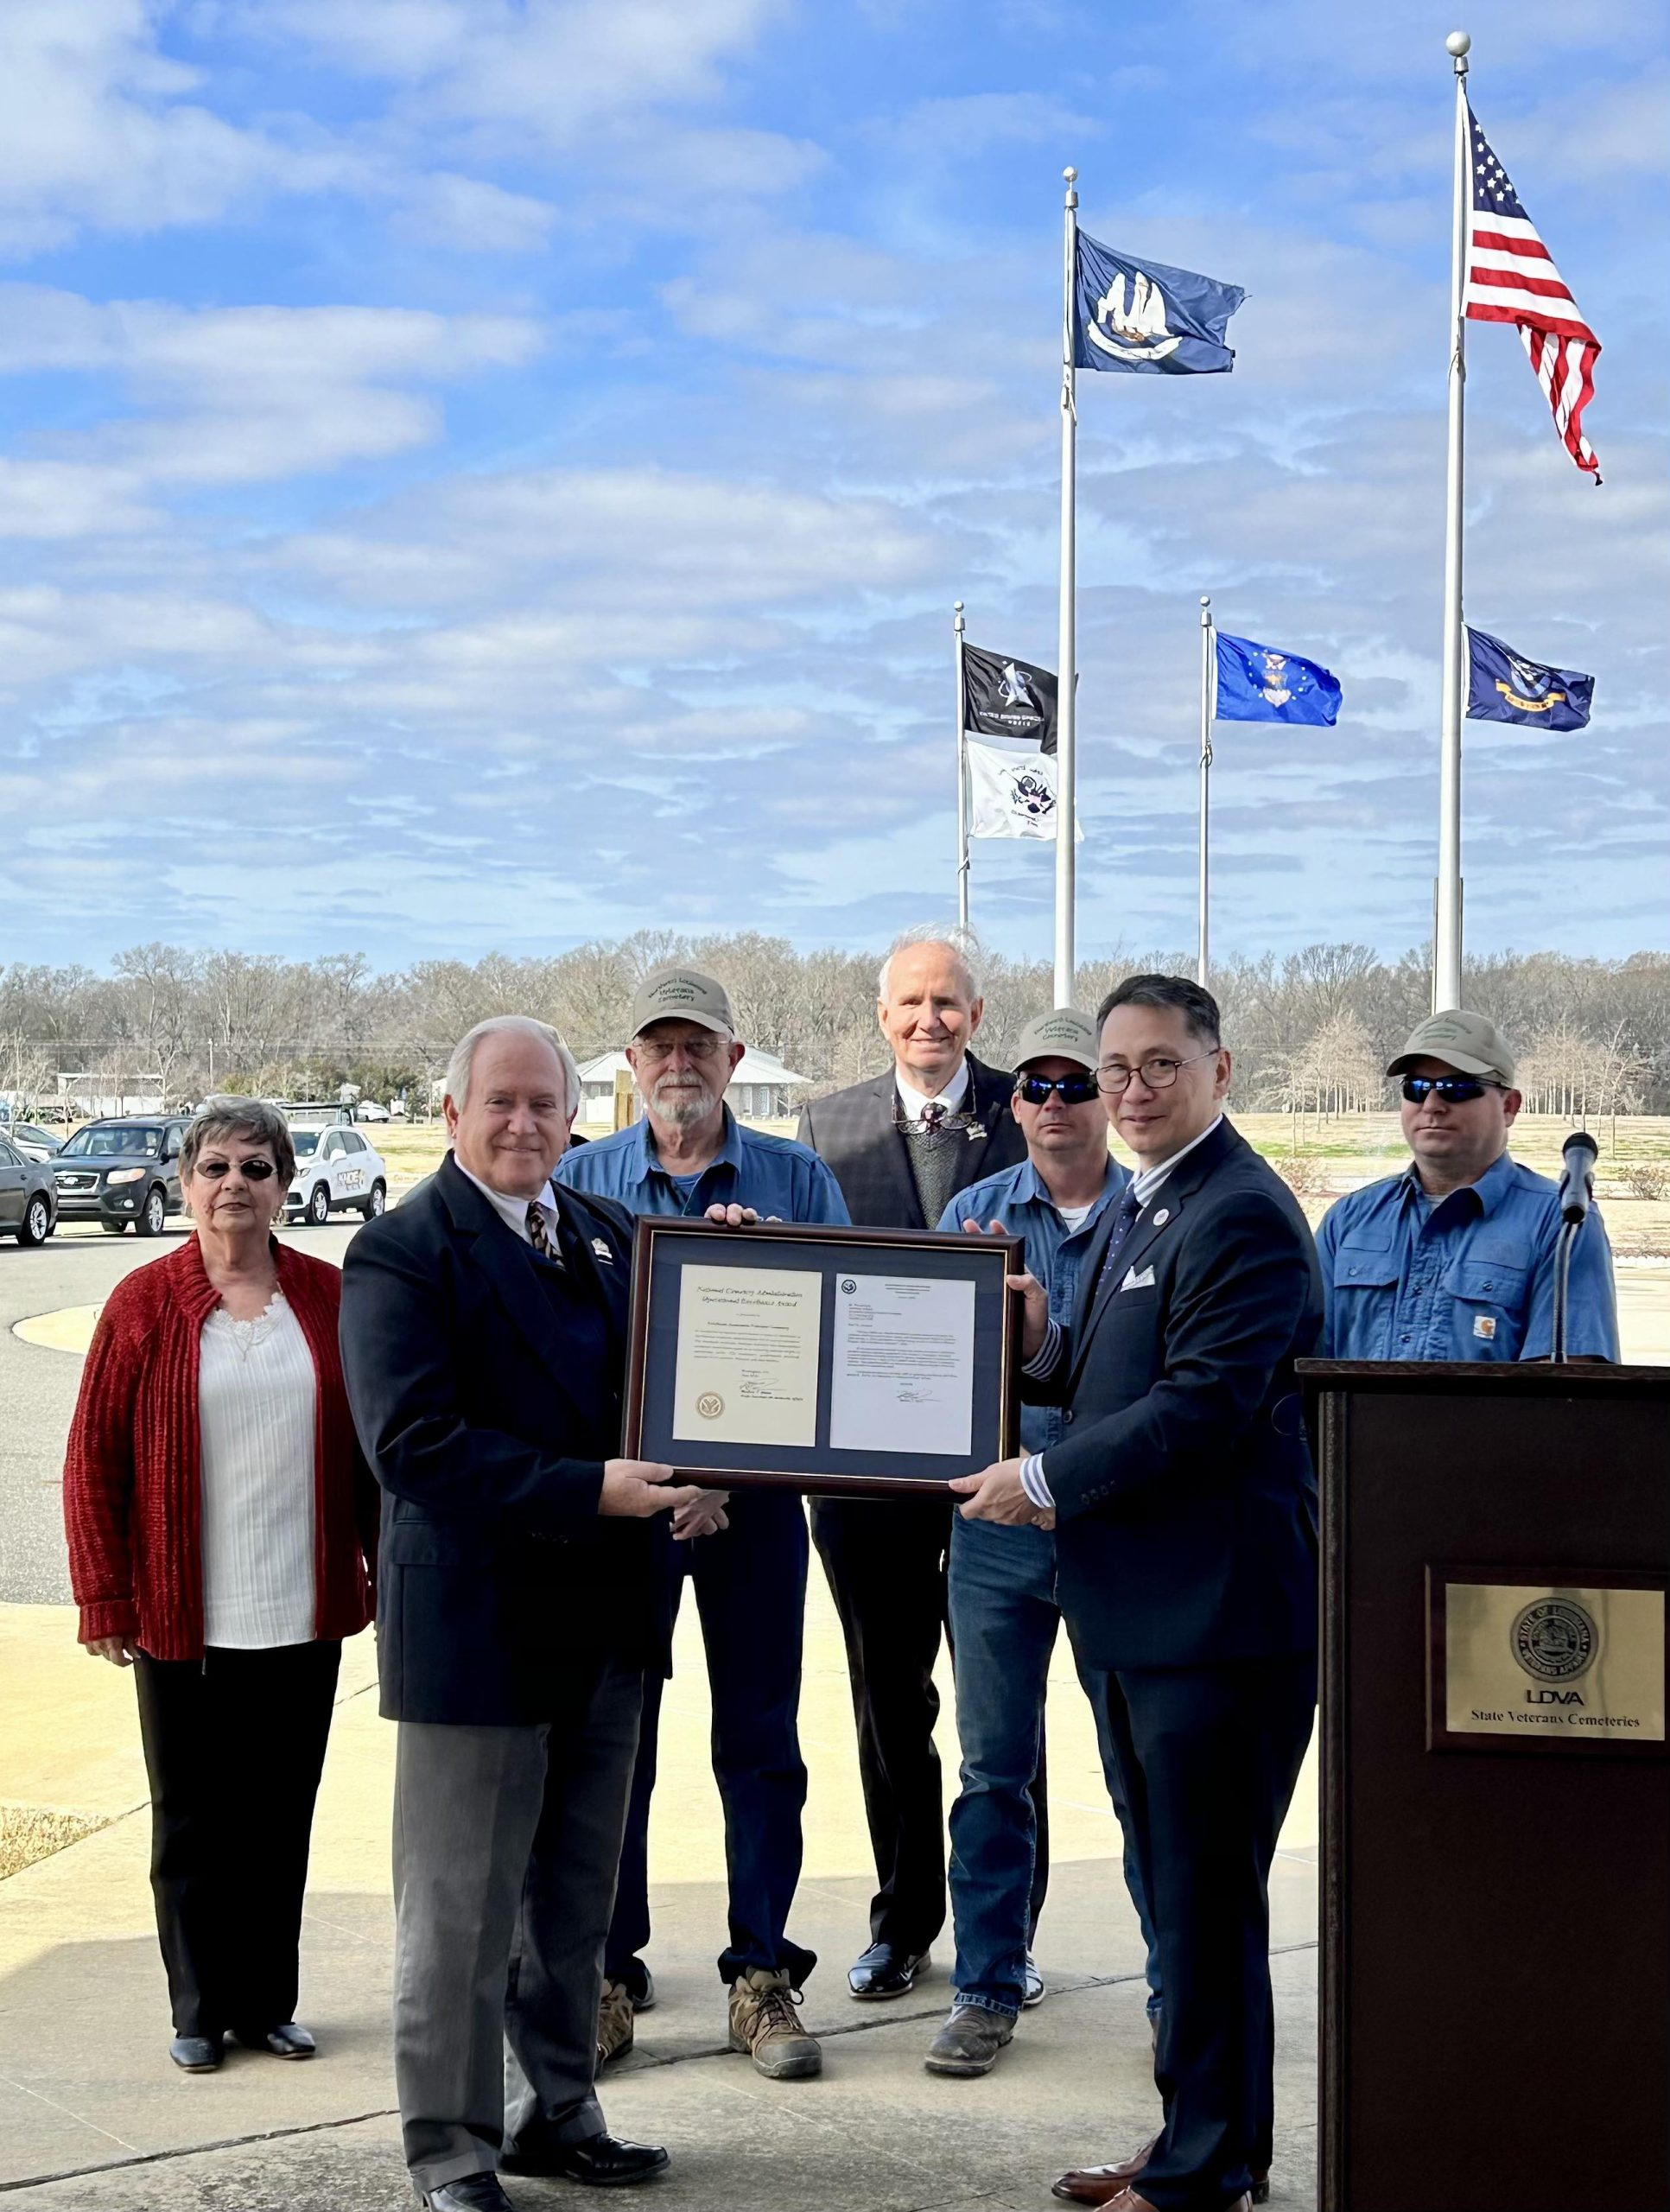
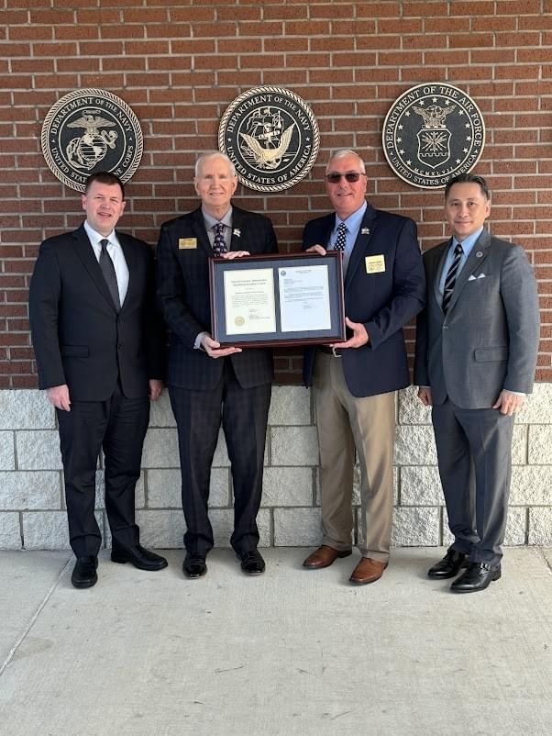
Veterans Affairs
State Veterans Cemetery Program
Northeast and Southwest Louisiana Veterans Cemetery Staffs Receive Federal VA Operational Excellence Awards
The staffs of the Northeast and Southwest Louisiana Veterans Cemeteries received the U.S. Department of Veterans Affairs’ National Cemetery Administration’s Operational Excellence Award in ceremonies at both cemeteries. James Earp, director of NCA’s Veterans Cemetery Grants Program presented the awards to Louisiana Department of Veterans Affairs Secretary Charlton Meginley, COL (USAF Ret), NELVC director Tim Johnson and SWLVC director Dwayne Guidry.
The Operational Excellence Award is given to state veteran cemeteries for excellent compliance during their triennial review, which is a rigorous process examining 95 NCA standards including interment operations, grounds and equipment maintenance and headstone alignment. This was the first review for the SWLVC since it’s opening on March 6, 2020, and the award serves as a testament to the high standards they uphold.
Source: Department of Veterans Affairs
6

Slide 7
Veterans Affairs
Veterans Homes
Louisiana’s Veterans Homes
Homes are located conveniently across the state in Jackson, Bossier City, Monroe, Reserve and Jennings.
Louisiana Veterans Homes
LDVA proudly operates five state-of-the-art Veterans Homes across the state.
Each facility offers a variety of services including:
Long- and short-term care
Rehabilitative therapies
Alzheimer’s and intermediate care
Skilled nursing
Mental health services
Centralized pharmacy services
Bossier City
Monroe
Jackson
Jennings
Reserve
7

Slide 8
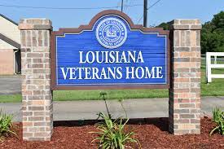
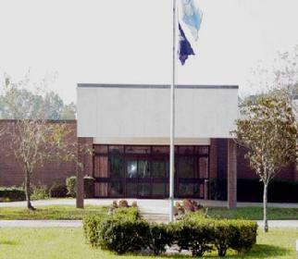
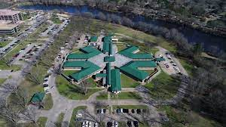
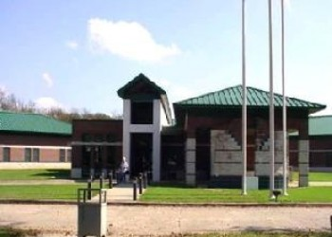
Veterans Affairs
Veterans Homes Daily Census, Occupancy Rate, and Cost Per Patient
Louisiana Veterans Home- Jackson, Louisiana
Averages | FY19 | FY20 | FY21 | FY22 | FY23
Daily Census | 109 | 113 | 88 | 89 | 86
Occupancy Rate | 84% | 88% | 68% | 69% | 67%
Cost per Patient per Day | $265 | $244 | $321 | $308 | $342
Cost Per Patient per Year | $96,725 | $89,060 | $117,165 | $112,420 | $124,830
Northeast Louisiana Veterans Home – Monroe, Louisiana
Averages | FY19 | FY20 | FY21 | FY22 | FY23
Daily Census | 142 | 138 | 115 | 111 | 118
Occupancy Rate | 91% | 88% | 74% | 71% | 78%
Cost per Patient per Day | $221 | $229 | $268 | $276 | $310
Cost Per Patient per Year | $80,665 | $83,585 | $97,820 | $100,740 | $113,150
Source: Office of Planning and Budget, Executive Budget Supporting Document
8

Slide 9
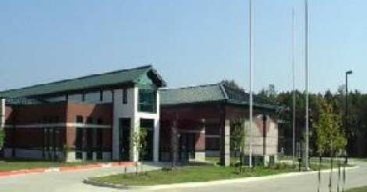
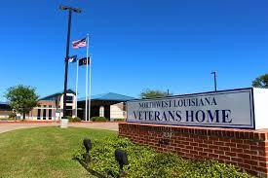
Veterans Affairs
Veterans Homes Daily Census, Occupancy Rate, and Cost Per Patient
Southwest Louisiana Veterans Home – Jennings, Louisiana
Averages | FY19 | FY20 | FY21 | FY22 | FY23
Daily Census | 143 | 136 | 116 | 111 | 120
Occupancy Rate | 94% | 87% | 74% | 71% | 77%
Cost per Patient per Day | $233 | $259 | $325 | $344 | $328
Cost Per Patient per Year | $85,045 | $94,535 | $118,625 | $125,560 | $119,720
Northwest Louisiana Veterans Home – Bossier Louisiana
Averages | FY19 | FY20 | FY21 | FY22 | FY23
Daily Census | 138 | 136 | 95 | 98 | 118
Occupancy Rate | 91% | 90% | 63% | 65% | 78%
Cost per Patient per Day | $236 | $249 | $346 | $347 | $310
Cost Per Patient per Year | $86,140 | $90,885 | $126,290 | $126,655 | $113,150
Southeast Louisiana Veterans Home – Reserve, Louisiana
Averages | FY19 | FY20 | FY21 | FY22 | FY23
Daily Census | 147 | 132 | 99 | 104 | 123
Occupancy Rate | 94% | 85% | 63% | 66% | 79%
Cost per Patient per Day | $239 | $274 | $307 | $282 | $288
Cost Per Patient per Year | $87,235 | $100,010 | $112,055 | $102,930 | $105,120
Source: Office of Planning and Budget, Executive Budget Supporting Document
9

Slide 10
Veterans Affairs
Changes in Funding since FY17
Change from FY17 to FY25 is 51% at Recommended
$93.9
$91.2
$91.6
$81.3
$71.8
$74.2
$67.4
$69.6
$62.2
$66.0
10

Slide 11
Veterans Affairs
Statewide Adjustments Recommended for FY25
Statewide Adjustments to Veterans Affairs Budget
11

Slide 12
Veterans Affairs
Non-Statewide Budget Adjustments Recommended for FY25
12

Slide 13
Veterans Affairs
FY25 Recommended Means of Finance
Non-SGF Sources of Funding:
Non-State General Fund funding sources for the Department of Veterans Affairs includes dollars derived from Interagency Transfers, Fees and Self-generated Revenues, Statutory Dedications, and Federal Funds.
Statutory Dedications come from the Louisiana Military Family Assistance Fund.
Interagency Transfers are derived from other Veterans Affairs agencies and homes.
Fees and Self-generated Revenues are derived from each parish's contribution towards providing a veterans service office. Fees and Self-generated Revenues for Veterans Homes are derived from the residents' ability to pay for part of their care and from employees and visitors purchasing meal tickets.
Federal Funds are derived from the U.S. Department of Veterans Affairs. Federal Funds for the homes are derived from the Veterans Administration for patient care days based on a reimbursement rate of $127.17 per day for the care of each veteran housed as reflected in the daily census and the Medicare eligible residents cost reimbursement from the U.S. Department of Veterans Affairs.
13

Slide 14
Categorical Expenditures
Examples of Categories
Departments expend funding in the five major categories listed below.
Personal Services
Salaries – Regular, overtime, and termination pay for Classified and Unclassified personnel.
Other Compensation – Wages, student labor, compensation for board members and/or board of trustees, evening instruction, university instructors, etc.
Related Benefits – Retirement contributions, post-retirement contributions/benefits, FICA tax, Medicare tax, group insurance contributions, compensated absences, other related benefits, taxable fringe benefits, etc.
Total Operating Expenses
Travel – In-state and Out-of-state, including meal reimbursement.
Operating Services – Advertising, printing, insurance, maintenance, rentals, data processing, internet costs, dues and subscriptions, mail delivery, telephones, data lines, vehicle tracking and telematics, utilities, depreciation, amortization, banking services, credit card fees, etc.
Supplies – office supplies and equipment, computers, clothing and uniforms, medical, pharmaceutical, food, automotive, repair and maintenance, software, etc.
Professional Services – Accounting, auditing, management consulting, engineering, architectural, legal, medical and dental, veterinary, information technology, etc.
Total Other Charges
Other Charges – Aid to school boards, local government, etc.; public assistance; miscellaneous charges; judgments, fines, and penalties; interest on judgments; punitive/compensatory damages; OC personal services, operating expenses, professional services; contract attorney expenses; recoupments; furlough; contractual services; interest expense; claim payments; commercial group insurance; reinsurance; loans issued; disbursements; etc.
Debt Service – Principal, interest, related charges, reserve requirement, amortization, and bond premiums.
Interagency Transfer Line-Item Expenditure – Any expenses paid for with Interagency Transfers – from commodities and services to equipment.
Acquisitions and Major Repairs
Acquisitions – Land; buildings; automobiles; aircraft; accessories; equipment; software; hardware; farm and heavy equipment; boats; capital outlay expenditures; construction; etc.
Major Repairs – Land improvement; buildings; automotive; grounds; boats; aircraft; movable equipment; farm equipment; medical; office; library; education; recreation; communication; other equipment; pollution remediation; etc.
Source: OPB Expenditure Budget adjustment form

Slide 15
Veterans Affairs
Categorical Expenditures at FY25 Recommended
The largest expenditure category in Veterans Affairs for FY25 Recommended is Total Personal Services at 66 percent of the budget.
Within this category, Salaries make up 67 percent of expenditures, while Related Benefits contributes 31 percent.
Total Other Charges at make up 14 percent of the budget and contains funding for the Louisiana National Guard Disability Claims and funding for The Boot, a new Louisiana 501(C)(3) veteran service organization to recruit and retain transitioning Military and Veterans from both Louisiana and the entire United States.

Slide 16
Veterans Affairs
FY25 Recommended Categorical Expenditures
Other Charges
$52,603 Military Honors Veterans Medals
$295,987 LaVetCorps
$215,528 Military Family Assistance Program
$1,499,600 The Boot
$670,000 Louisiana National Guardsmen Burial
$3,848,009 Funding for Louisiana National Guard Disability Claims
$20,000 Indigent burials
$81,997 Funding for grounds keeping
Interagency Transfers
$128,802 Rent in state-owned buildings
$115,579 Office of Risk Management (ORM)
$4,282 Office of State Procurement
$13,312 Capitol Park Security
$4,472 State Treasury Fees
$96,718 Office of Technology Services (OTS)
$132,189 Legislative Auditor Fees
$7,454 Uniform Payroll System (UPS) Fees
$40,505 Civil Services Fees
$43,501 Office of Telecommunications Management
$62,839 Office Space Lease
$5,825 Office of Technology Services (OTS)
$5,987 Office of Risk Management
$178,781 Office of Technology Services Fees
$28,496 Transfers to other state agencies for services
$22,000 Administrative Program Support
$3,130 Office of Risk Management
$30,685 Transfers to other state agencies for services
$48,252 Office of Risk Management
$11,760 Office of Technology Services
$19,124 Transfers to other state agencies for services
$99,721 Office of Technology Services (OTS) Fees
$240,998 Risk Management fees
$30,261 Civil Service Fees
$7,313 Uniform Payroll System (UPS) Fees
$7,818 Office of State Procurement
$24,707 Dixon Correctional Institute work crew
$36,910 ELMHS Natural Gas and Gasoline
$2,000 Villa Feliciana medical complex for radiology, lab and physician on-call services
$15,000 IT Equipment lease through OTS
$710,720 Transfer to LDVA, other Veterans Homes and agencies for services and shared positons
Professional Services
$73,420 Legal services
$4,600 To include burials and cemetery construction
$30,000 Medical Services
$36,000 X-ray and EKG Services
$2,000 Mobile Ultrasound Services
$13,200 Pharmacy Consultant Services
$588,850 Occupational, Physical, and Speech Therapy Services
$29,950 Accounting and Auditing Services
$39,391 Funding contract RNs, LPNs, and CNAs
$29,950 Accounting and Auditing Services
$71,700 Management Consulting Services
$423,264 Occupational and Physical Therapy Services
$52,614 Other Professional Services
$4,350 Accounting and Auditing Services
$25,800 Management Consulting Services
$74,482 Medical and Dental Services
$443,938 Occupational and Physical Therapy Services
$55,332 Other Professional Services
$865,949 Therapy, laboratory, x-ray, and pharmacy services
$78,308 Management Consulting Services
$35,211 Medical and Dental Services
$487,068 Occupational and Physical Therapy Services
$38,838 Pharmacy Services
$62,405 Other Professional Services
Source: FY25 Executive Budget Supporting Documents.
16

Slide 17
Veterans Affairs
FY25 Recommended Categorical Expenditures
Interagency Transfers
$112,432 Office of Technology Services (OTS) Fees
$235,932 Risk Management Fees
$7,266 Uniform Payroll System (UPS) Fees
$42,951 Civil Services Fees
$1,000 Printing Services
$11,745 Office of State Procurement
$70,200 IT Equipment lease through OTS
$515,493 Transfer to LDVA, other Veterans Homes and
agencies for services and shared positons
$361,049 Office of Risk Management
$39,342 Civil Service Fees
$6,891 Uniform Payroll System (UPS) Fees
$21,335 Office of State Procurement
$187,523 Office of Technology Services (OTS)
$611,794 Transfer to LDVA, other Veterans Homes and
agencies for services and shared positons
$40,276 Civil Service Fees
$261,527 Risk Management Premium (ORM)
$6,323 UPS Fees
$14,511 Office of State Procurement
$180,810 Office of Technology Services (OTS)
$458,093 Transfer to LDVA, other Veterans Homes and
agencies for services and shared positons
$38,749 Civil Service Fees
$17,437 Office of State Procurement
$6,993 Uniform Payroll (UPS)
$346,323 Risk Management Premium (ORM)
$300,642 Office of Technology Services (OTS)
$194,594 Transfer to LDVA, other Veterans Homes and
agencies for services and shared positons
Acquisitions and Major Repairs
$80,019 1 2017 Dodge Caravan Braun Rear Ramp
$60,000 1 Hospital Bed
$56,232 1 Ford F-150 Regular Cab
$10,667 4 Medline Vital
$80,000 1 2019 Dodge Caravan with Braun Lift
$2,700 1 Food prep steam table
$3,993 1 Hot Plate Dispenser
$40,000 1 Pass Through Refrigerator
$35,000 12 Long wide low beds
$3,215 1 Micro Scrubber
$275 5 Utility Cart
$225 5 Trash Can Dolly
$90,655 Replace carpet in the conference room, office, and family rooms, with laminate flooring.
$3,400 2 Treatment Carts
$7,000 40 Southgate bedside cabinets to match Alterra Maxx beds
$28,123 20 Alterra Maxx Beds with Head/Footboards and Assist rails
$9,628 4 Welch Alyn 4400 Vital sign machines
$1,890 4 Rolling Carts for 4400 Vital sign machines
$2,280 2 Dreamstation bipaps
$23,517 1 Whirlpool
$5,850 40 Wall Suction Regulators with Niples and Diamond Fitting
$3,220 7 Geri Chairs
$4,950 10 Invacare Perfecto Oxygen Concentrators
$1,700 2 Washing Machines
$1,700 2 Drying Machines
$5,000 Expand Wander Guard to Wing 4 exit (alarm only)
$35,000 Refurbish nursing station & restroom countertops
$7,000 Replace Canopy Lights
$49,000 Telephone System
$5,000 Expand Wander Guard to Wing 4 exit
$20,000 Replace Outdoor Signage
$48,000 Tying well to facility piping for emergency preparedness
Source: FY25 Executive Budget Supporting Documents.
17

Slide 18
Veterans Affairs
FTEs, Authorized T.O., and Other Charges Positions
The full-time equivalent or FTE definition refers to the number of hours considered full-time. For example, if an agency considers 40 hours full time, and there are two employees working 20 hours per week, those two employees would be 1.0 FTE.
Authorized Positions are those referred to in the Table of Organization (or T.O.) for each department. This count includes only those positions paid for from the Salaries expenditure category for the organization units and agencies included in each department’s appropriation. This excludes positions paid for from other expenditure categories, such as wages or per diem.
Other Charges positions are authorized under R.S. 39:2(5)(b) …
(5)(b) "Authorized other charges positions" means the number of positions in an appropriation bill to be funded by the other charges continuing category of the accounting system for the state. The number may be adjusted during a fiscal year in accordance with law.
[Act 377 of 2013 by Rep. Burrell]
Positions coded in the Other Charges expenditure category
These positions are usually associated with federal grants
FY24 number of funded, but not filled, positions as of January 2024 = 177
18

Slide 19
Veterans Affairs
Related Employment Information
Salaries and Related Benefits for the 851 Authorized Positions are listed below in Chart 1.
In Chart 2, benefits are broken out to show the portion paid for active versus retired employees.
This is where payments for the Unfunded Accrued Liability (UAL) can be found.
1.
Personal Services | 2022 Actual | 2023 Actual | 2024 Enacted | 2025 Recommended
Salaries | $35,041,535 | $37,351,167 | $39,723,115 | $41,194,304
Other Compensation | $802,486 | $1,297,869 | $1,571,066 | $1,611,066
Related Benefits | $15,221,177 | $16,170,741 | $20,604,518 | $18,837,335
Total Personal Services | $51,065,197 | $54,819,777 | $61,898,699 | $61,642,705
Average T.O. Salary = $44,892
Examples of Other Compensation include pay for WAE employees, part-time employees, student workers, etc.
Department Demographics | Total | %
Gender
Female | 527 | 75.5
Male | 171 | 24.5
Race/Ethnicity
White | 276 | 39.5
Black | 413 | 59.2
Other | 9 | 1.3
Currently in DROP or Eligible to Retire | 56 | 8.02
2.
Related Benefits FY25 Recommended | Total Funding | %
Total Related Benefits | $18,837,335
UAL payments | $10,120,363 | 54%
Retiree Health Benefits | $676,984
Remaining Benefits* | $8,040,008
Means of Finance | General Fund = 15% | Other = 85%
* Remaining Benefits include employer contribution to authorized positions’ retirement, health, Medicare, FICA, Emoluments etc. The authorized positions include authorized T.O. positions and authorized other charges positions, both filled and vacant.
Other Charges Benefits
$0
19

Slide 20
Veterans Affairs
FY25 Recommended Total Authorized Positions by Agency
20

Slide 21
Veterans Affairs
FY25 Discretionary/Non-Discretionary Comparison
FY25 Recommended
Discretionary — $82,808,922
Discretionary SGF = $14,787,803
Discretionary IAT = $2,257,928
Discretionary FSGR = $13,663,009
Discretionary DEDS = $215,528
Discretionary FED = $51,884,655
Discretionary T.O. = 851
Non-Discretionary SGF = $2,148,442
Non-Discretionary IAT = $221,502
Non-Discretionary FSGR = $1,270,613
FY25 Recommended
Non-Discretionary — $11,058,338
Non-Discretionary DEDS = $0
Non-Discretionary FED = $7,417,782
Non-Discretionary T.O. = 0
21

Slide 22
03-Veterans Affairs
Enacted & FYE Budget vs. Actual Expenditures FY20 to FY23
FYE Budget = “Fiscal Year End” Budget includes all in-house and regular BA-7s through June 30 of the fiscal year. For FY24, it is as of January.
FY24 Known Supplemental Needs:
$0
$80.1 m. = FY24 Adjusted Budget x 0.916
FY24 General Fund Reversions:
$1,002,622
22

